Slide 1
Lookup Family
[Excel Functions]

Slide 2
Introduction
In Excel, a lookup function helps you find specific information within a table or range of cells.
It's like searching for a particular piece of data, such as a name or a number, in a large set of information.
It's handy for tasks like finding prices for products, matching names with corresponding IDs, or retrieving any other related information based on what you're looking for.

Slide 3
TYPES
VLOOKUP
HLOOKUP
INDEXMATCH
XLOOKUP
Stands for "Vertical Lookup." It searches for a value in the first column of a table and returns a value in the same row from a specified column.
Stands for "Horizontal Lookup." It works similarly to VLOOKUP but searches for the value in the first row of a table and returns a value in the same column from a specified row.
This combination of functions allows you to find a value in a table based on its row and column headers. INDEX returns the value of a cell in a specific row and column of a range, while MATCH searches for a specified value in a range and returns the relative position of that item.
Similar to VLOOKUP and HLOOKUP but with more features and flexibility. It can search in both vertical and horizontal directions and can return results from any column or row in the lookup array.

Slide 4
VLOOKUP
SYNTEX :-
=VLOOKUP(lookup_value, table_array, col_index_num, [range_lookup])
lookup_value: The value you want to search for.
table_array: The range of cells that contains the data.
col_index_num: The column number in the table from which to retrieve the value.
[range_lookup]: Optional. TRUE for approximate match (default), FALSE for an exact match.

Slide 5
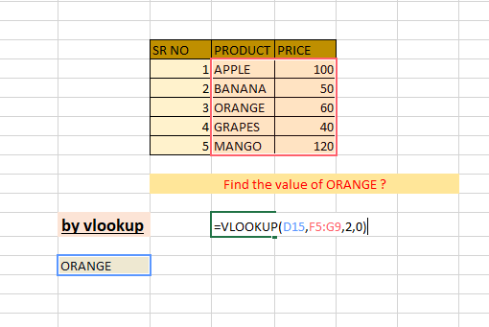
EXAMPLE

Slide 6
HLOOKUP
SYNTEX :-
=HLOOKUP(lookup_value, table_array, row_index_num, [range_lookup])
lookup_value: The value you want to search for.
table_array: The range of cells that contains the data.
row_index_num: The row number in the table from which to retrieve the value.
[range_lookup]: Optional. TRUE for approximate match (default), FALSE for an exact match.

Slide 7
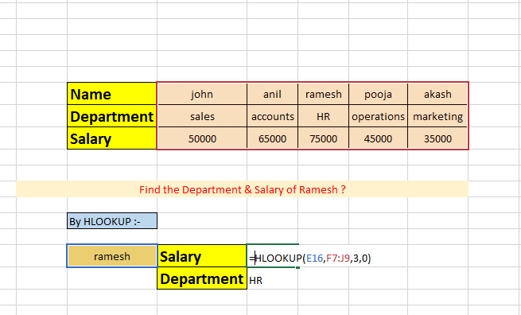
EXAMPLE

Slide 8
INDEX-MATCH
SYNTEX :-
=INDEX(return_range, MATCH(lookup_value, lookup_range, [match_type]))
return_range: The range of cells containing the values you want to return.
lookup_value: The value you want to search for .
lookup_range: The range of cells where the lookup value is located.
[match_type]: Optional. 1 for less than, 0 for exact match, -1 for greater than. (Default is 0 for exact match)

Slide 9
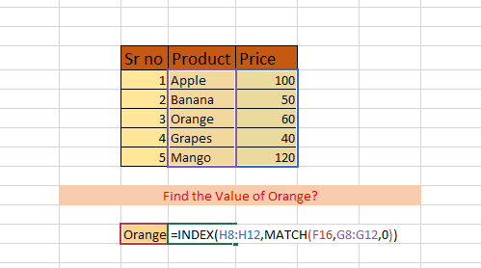
EXAMPLE

Slide 10
XLOOKUP
SYNTEX :-
=XLOOKUP(lookup_value, lookup_array, return_array, [if_not_found], [match_mode], [search_mode])
lookup_value: The value you want to search for.
lookup_array: The range or array to search.
return_array: The range or array containing the values to return.
[if_not_found]: Optional. The value to return if no match is found. If omitted, XLOOKUP returns #N/A.
[match_mode]: Optional. 0 for exact match, -1 for exact match or next smaller item, 1 for exact match or next larger item. (Default is 1)
[search_mode]: Optional. 1 for first-to-last search (default), -1 for last-to-first search, 2 for binary search. (Default is 1)

Slide 11
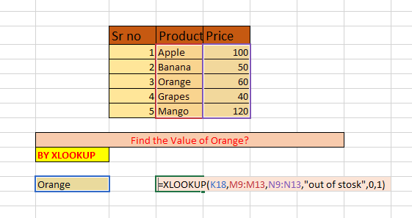
EXAMPLE

Slide 12
THANK YOU

